Slide 1
Patterns & Best Practices For Moving From RDBMS to Azure Storage
DotNetConf 2013

Slide 2

Caitie McCaffrey
Software Development Engineer
343 Industries
@CaitieM20
CaitieM.com

Slide 3


Notes:
I joined 343 in 2010 as a Web Services Engineer working on “projects & experiences” aka Halo 4.
We inherited the Halo Services Stack (IIS & SQL)
For Halo 4 we decided to build our Game Services in Azure
We moved from a totally relational one database world to the cloud and its non-relational storage.

Slide 4
Azure Storage
Blob - Unstructured Binary
Table - Structured Non Relational
SQL Database - Relational Storage
Notes:
Azure Storage consists of 3 storage options

Slide 5
Azure Table
“Windows Azure tables are ideal for storing structured, non-relational data.”
Notes:
Non-relational = NoSQL
Data is replicated 3 times
Automatically Scales Out

Slide 6
Azure Table Structure
Tables: Collection of Entities
Entities: Set of Properties
Properties: Name Value Pair
Notes:
Tables – collection of entities, no schema on entities
Entities – Set of Properties Similar to database row, Identified Uniquely by PartitionKey and RowKey
Properties – Name Value Pair

Slide 7
Entities
Partition Key – identifies which partition an entity belongs to
Row Key – uniquely identifies an entity in a partition
Timestamp – last time entity was modified
Notes:
Parition Key – string that identifies which partition an entity belongs to
Row Key – string that uniquely identifies an entity in a partition
Timestamp – DateTime Last time entity was modified
Partition Key + Row Key = Unique Identifier (single clustered index in table)
Sorted by partition key in ascending order & then row key in ascending order

Slide 8
Entities & Queries
Azure Table supports only one Key per Entity.
Partition Key + Row Key = Unique Identifier

Slide 9
Properties are Name Value Pairs
Type | Numerics | Date & Time | Binary | Character Strings | Other
Azure Table | Int32 | DateTime | byte[] | Strings (UTF 16 encoded Value) | Guid
 | Int64 |  |  |  | Bit
 | Double
SQL | BigInt |  |  |  | Bit
 | Int
 | SmallInt | Date |  | Char
 | TinyInt | DateTime |  | Text
 | Money | DateTime2 | Binary | Varchar
 | SmallMoney | DateTimeOffset | Image | Nchar
 | Numeric | SmallDateTime | VarBinary | Ntext
 | Float | Time |  | NVarChar
 | Decimal
 | Real

Slide 10
Table Partitions
Entities with the Same Partition Key
Azure Table service supports Batch Transactions on entities that are in the same Table and belong to the same Partition.
Notes:
Entity Group Transaction
Each Entity Appears once
Up to 100 Entities etc…
Putting entities in the same partition allows you to perform Transactions and get ACID support.

Slide 11
Table Partitions
A Single Partition Server handles all requests for a Single Table Partition
Notes:
Here’s the catch, entities in the same partition are all served from the same machine.
Transaction Support and Scale are in direct conflict in Azure Table

Slide 12

Goldilocks & Azure Storage
“This Partition Size is Too Big. It Won’t Scale!”
Notes:
Transactions in a NoSQL Database hooray!
I’ll put all my data in one Table Partition.
But then it didn’t scale

Slide 13
Goldilocks & Azure Storage
“This Partition Size is Too Small. Not Enough Transaction Support!”
Notes:
To fix the Scale problem Goldilocks then put every entity in her Table in its own Partition, but then she had no Transaction Support!

Slide 14
Goldilocks & Azure Storage
“This Partition Size is Just Right! Scale & Just Enough Transaction Support”
Notes:
Finally Goldilocks sat down and thought about her application and data needs, and came up with a way to partition her data so she got the transaction support she needed, and the scale she desired.

Slide 15
Moral of the Story:
Data must be structured to support scale & queries

Slide 16
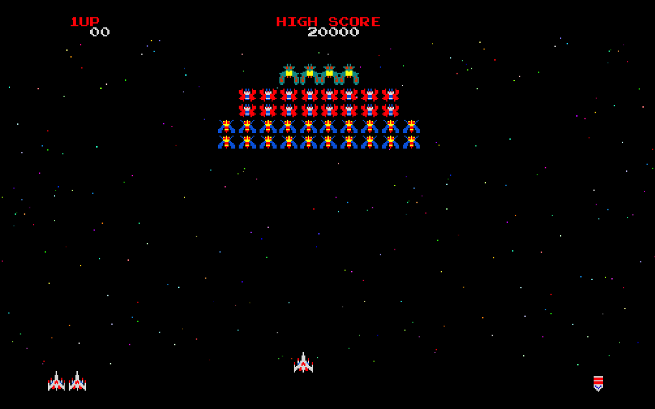
Simple Stats Example
Notes:
Players interact with your game potentially from multiple devices
Players have a unique Identity
Want to keep statistic totals for players in your game
Also want players to be able to see stats for individual games.
Statistics are uploaded at game end

Slide 17
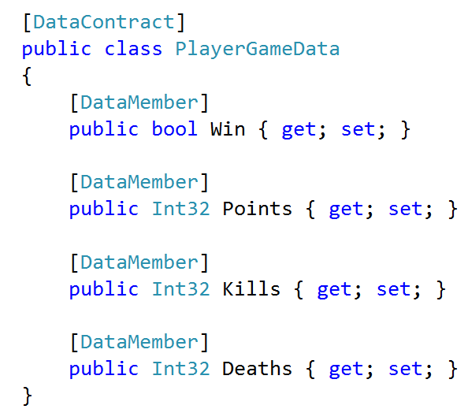
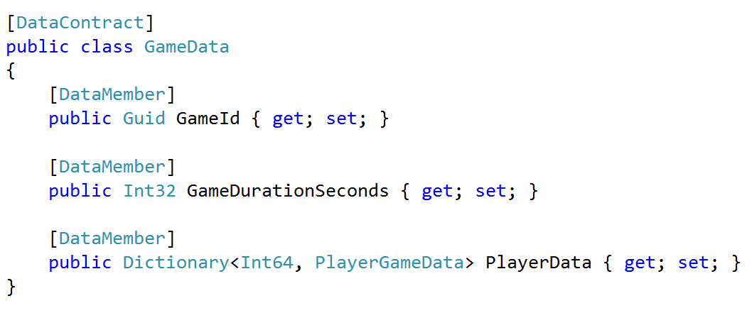
Simple Stats - Stats Data

Slide 18
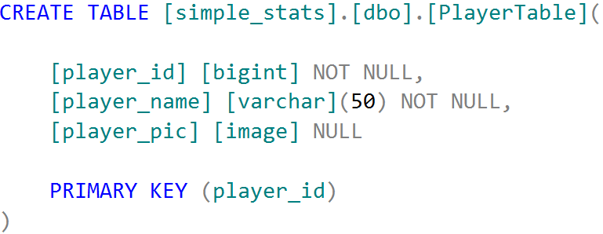
Simple Stats: SQL

Slide 19
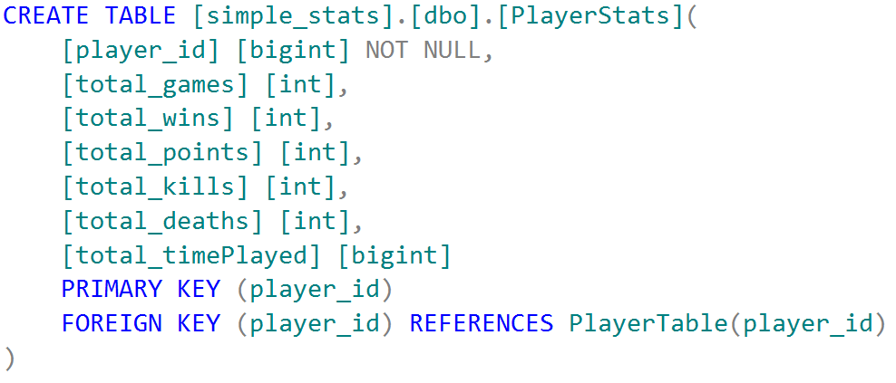
Simple Stats: SQL

Slide 20
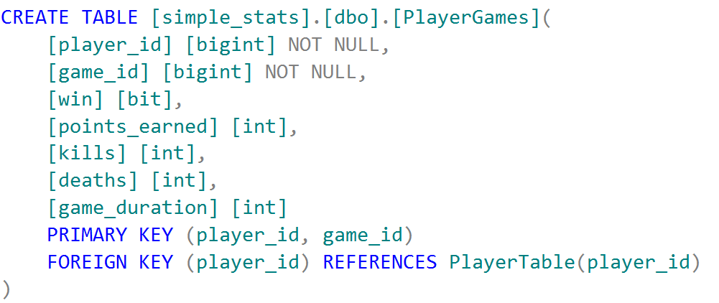
Simple Stats: SQL

Slide 21

Simple Stats: Azure Storage
What Transactions do I want?
Totals & Game Data Both Written
What Queries do I need?
Total player statistics
All games a player has played
Show stats for single game
How Do I Partition The Data?
Game Id or Player Id
Notes:
Choose a Partition Key
Games or Player
What Transactions do we want
On game end, update player totals & ensure game data is written
Queries
Show Player Statistics
Show me all the games I’ve played
Show me statistics for a single game.

Slide 22
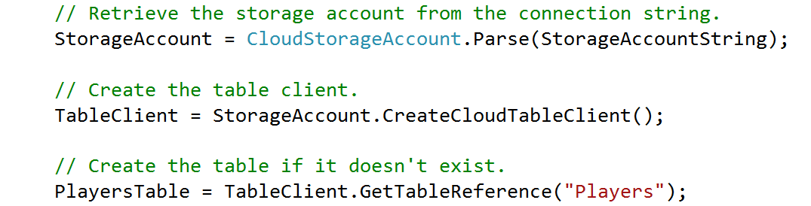
Simple Stats: Creating a Table
Notes:
// Retrieve the storage account from the connection string.
StorageAccount = CloudStorageAccount.Parse(StorageAccountString);
// Create the table client.
TableClient = StorageAccount.CreateCloudTableClient();
// Create the table if it doesn't exist.
PlayersTable = TableClient.GetTableReference("Players");

Slide 23
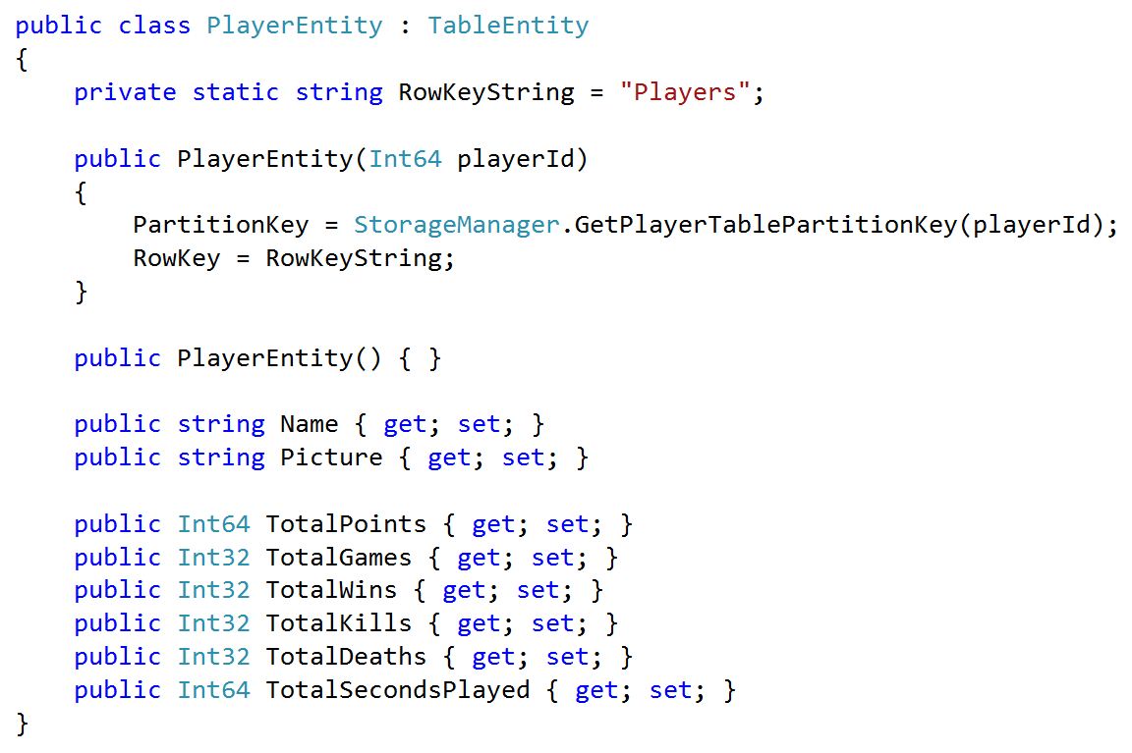
Simple Stats: Player Entity

Slide 24
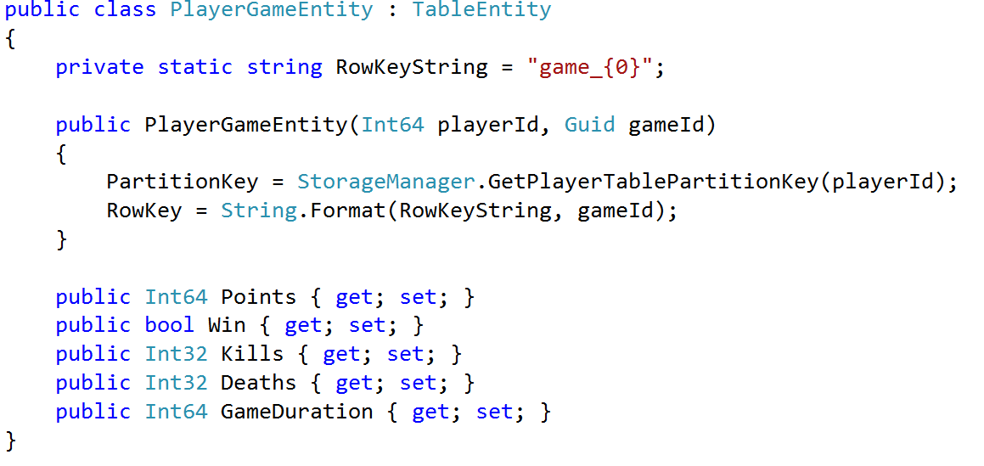
Simple Stats: PlayerGameEntity

Slide 25
Code Break
“We Don’t Know How To Make Perfect Software”
~Nathan Marz
Notes:
Code Break
Databases CRUD (Create, Read, Update, Delete)
Immutable Data No: Update & Delete
Why?
Code has bugs
People make mistakes
Having an Immutable Data Source means can always replay events
Also gives you audit logging. (How did we get to the state we are in)

Slide 26
Code Break
The Worst Error Is Data Loss or Data Corruption. It is Unrecoverable.

Slide 27
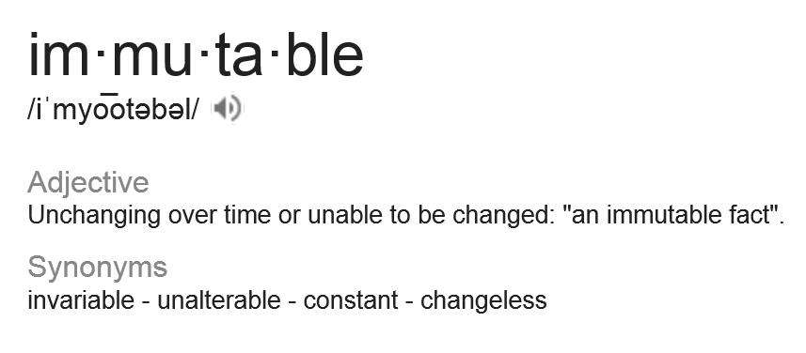
Data Immutability
Create
Read
Update
Delete

Slide 28
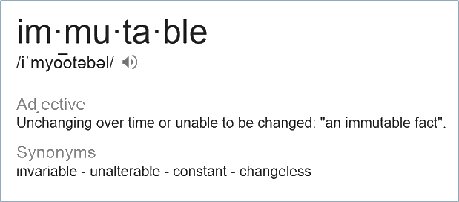
Code Break: Immutability
Data Immutability
Create
Read
Update
Delete
Create
Read
Update
Delete

Slide 29
Immutability in the Real World
“Event” Entities: Source of Truth is Immutable
Aggregate “View” Entities: use all of CRUD.
Notes:
Purely Immutable data stores aren’t practical
Immutable Data Rows & View Rows
View Rows
Can be updated & deleted
Can always be reconstructed from the Immutable data rows

Slide 30
More Immutability Benefits
Idempotent Writes to a Partition
Flexibility to add new views later
Data Audit Log

Slide 31
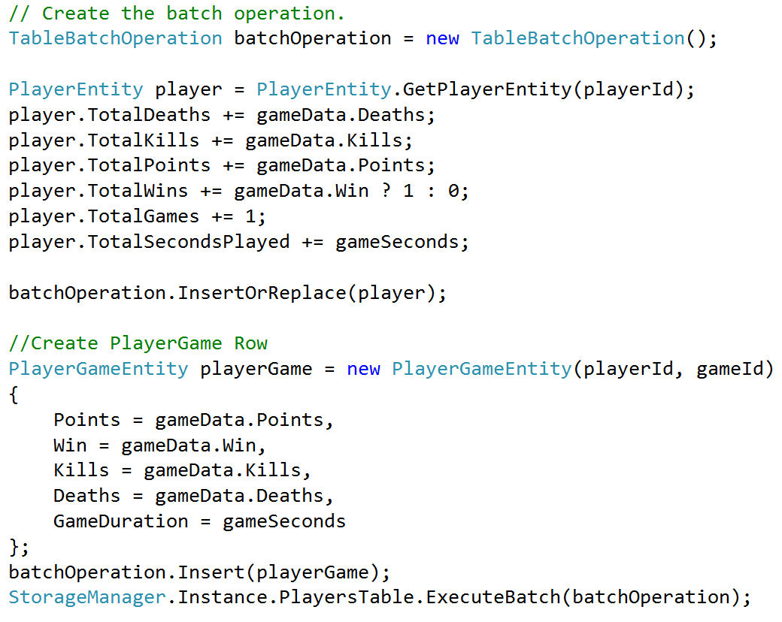
Simple Stats: Process Stats

Slide 32
Show What Partition Would Look Like

Slide 33
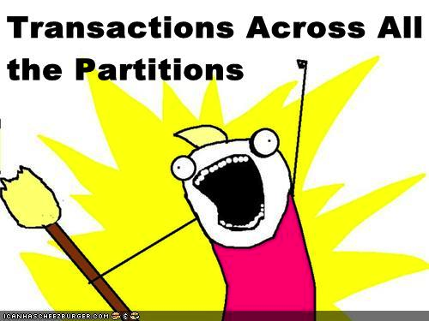
What About Distributed Transactions?
Notes:
What about multiplayer games. I need to ensure all the stats write for all the players. But I can only get transactions in one Partition.

Slide 34
Google Spanner
“Spanner is Google’s scalable, multi-version, globally distributed, and synchronously-replicated database. It is the first system to distribute data at global scale and support externally-consistent distributed transactions.”
~James C. Corbett et al

Slide 35
Saga Pattern
Transaction Model for Long Lived Activities or Distributed Transactions.
Good For Long-Lived Transactions or Distributed Transactions where ACID and 2 phase commit can’t be used.
No Centralized Coordination, No Centralized State

Slide 36
Saga is a Failure Management Pattern
Work is split into component Transactions
Each component transaction has a compensating transaction
On failure compensation transaction is executed
Compensation Transaction does not necessarily restore DB to previous state, but from a semantic point of view it has been rolled back

Slide 37
Sagas in Simple Stats
Player Partitions can be distributed across multiple nodes.
We can guarantee Transaction behavior for saving a single players stats
Never want to count stats twice.
If one Player fails to save replay stats across whole system, until everyone returns success.
Because our writes are Idempotent we can do this.

Slide 38
Thanks
Big thanks to the rest of the Halo Services Team.

Slide 39
Questions
Code Samples will be up on my GitHub

